Slide 1

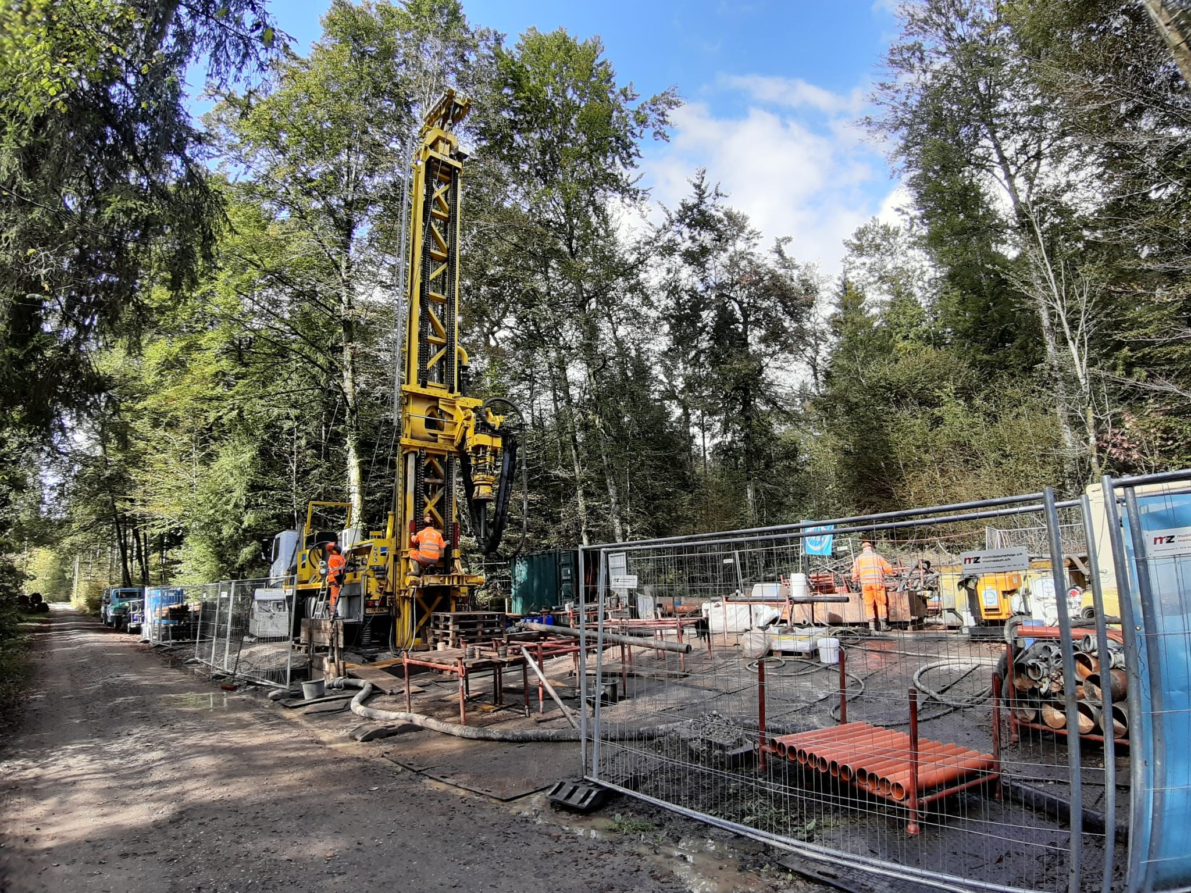


Image-based Classification of Sediments in Drill Cores
ADS CAS Final Project
10.08.2025
Patricio Becerra and Sebastian Schaller

Slide 2
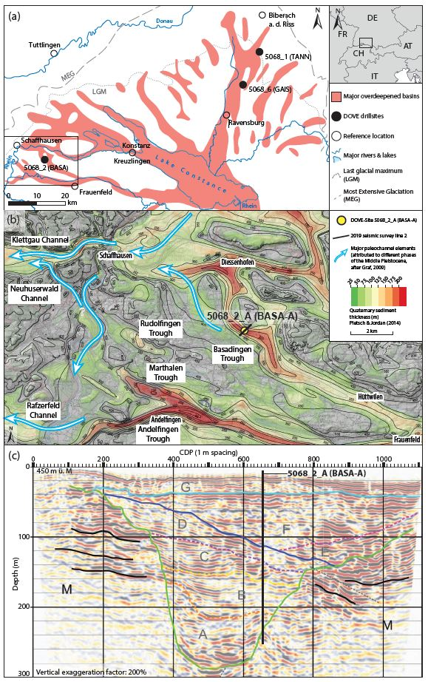
Introduction and background
Glacial extents of the Rhine Glacier
Seismic line
Local overdeepenings
Drill core

Slide 3
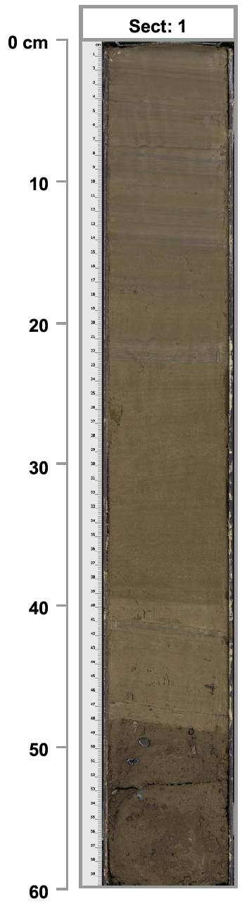
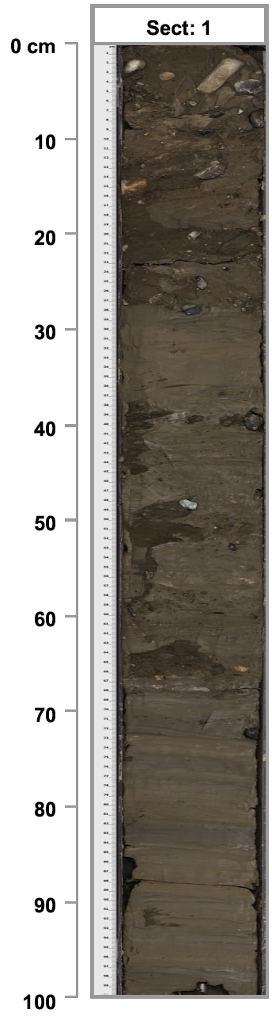
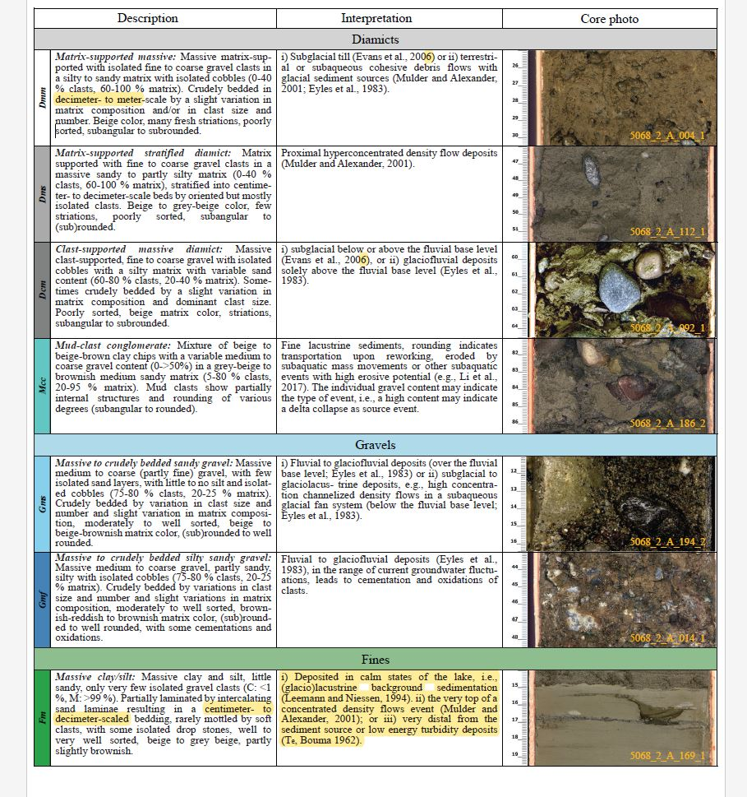
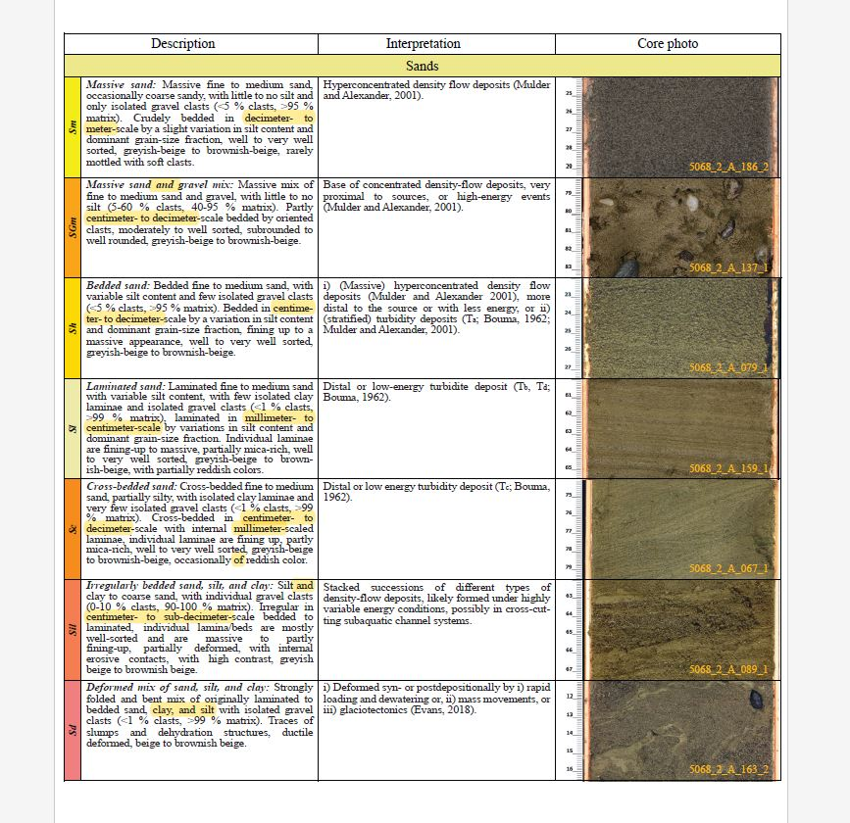
Introduction and background
High-resolution scanned images of sediment drill cores were used to classify the unconsolidated sediments into several lithoclastic types (e.g. gravel, sand, or fine clays)
The goal of our Module 6 project was to set the foundation for a deep learning model that can classify the sediments in a drill core image of unconsolidated quaternary sediments → Image segmentation
The full model is Patricio’s half of our CAS project (the other half was presented by Sebastian and published)
Diamict
Gravel
Advantages:
Visual litho-classification takes months
Optimizes the development of stratigraphic models
Sand
Fines

Slide 4
Project Tasks & Objectives
Create training, test and validation datasets from a subset of the previously visually litho-classified images
Label the image data → i.e. manually create image segmentation masks for the selected subset of previously classified images
Write a basic model based on similar image segmentation models in the literature [e.g. DiMartino et al., 2023]
Evaluate initial results and indicate likely future steps

Slide 5
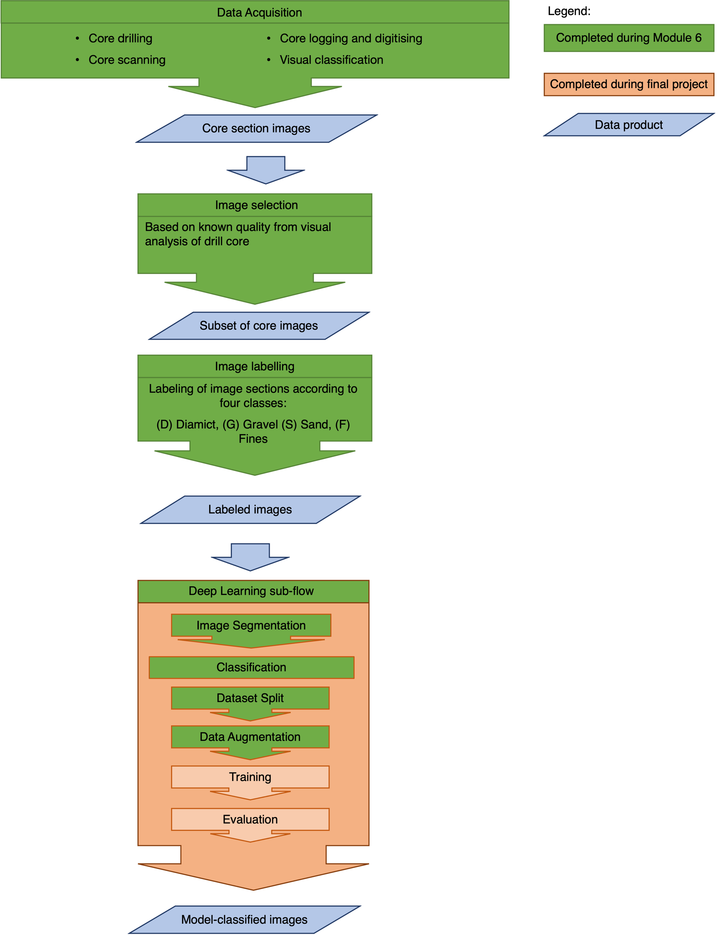
Data flow
Several steps of the workflow were completed during the CAS modules
The initially envisioned final project goal (The construction of image and data-based stratigraphic columns to cross-correlate with each other and with the visual-based stratigraphic column) was unfortunately not achievable in the timeframe
Nevertheless, the classification of images by the deep learning model was achieved with an acceptable degree of accuracy and success.

Slide 6
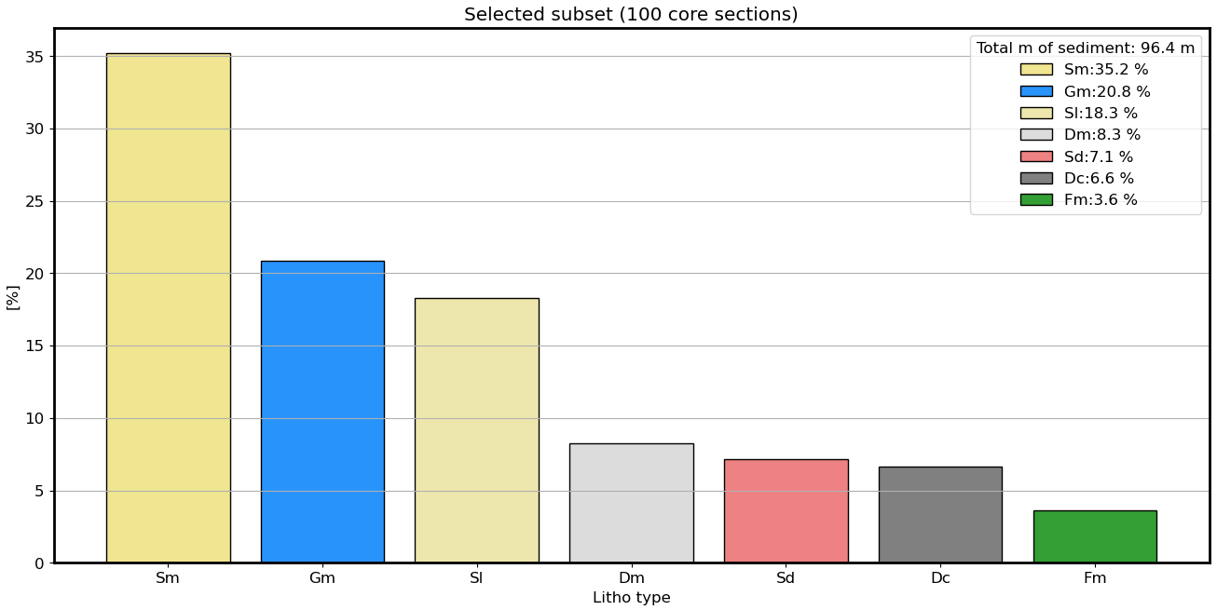
Dataset selection

Slide 7
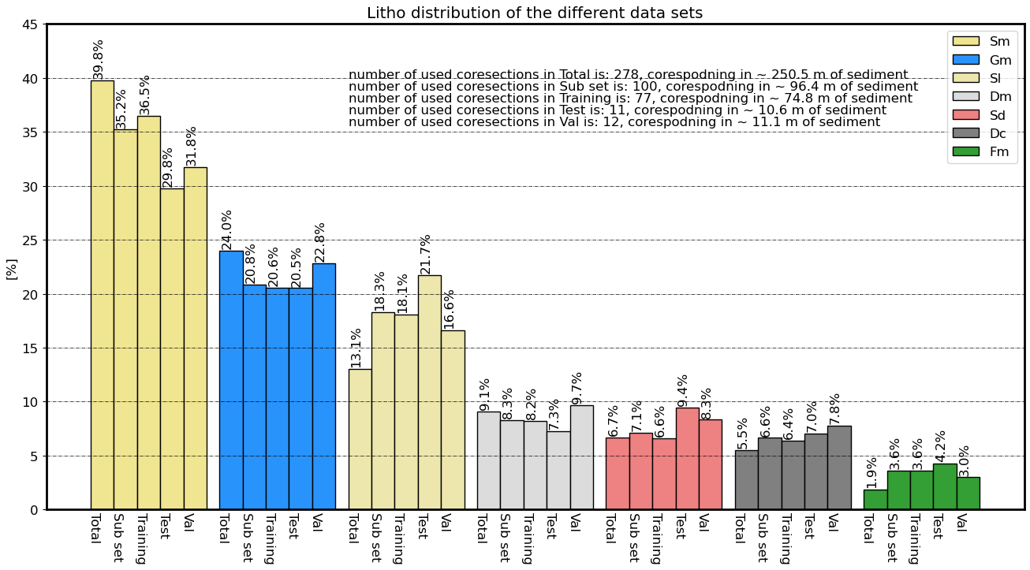
Dataset selection

Slide 8
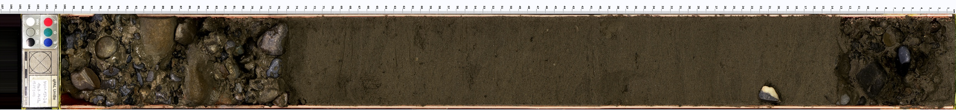

Data labeling: Manual image segmentation
Creating image masks
Massive Gravel
Massive Gravel
Laminated Sand

Slide 9
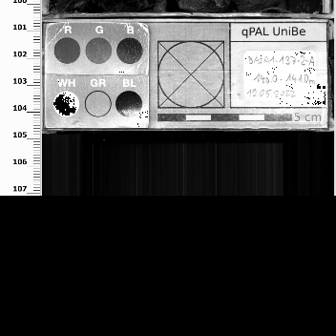
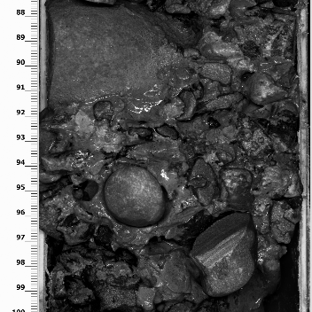
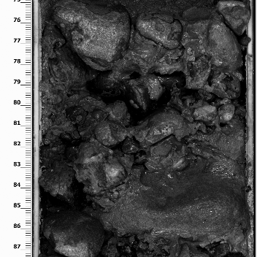
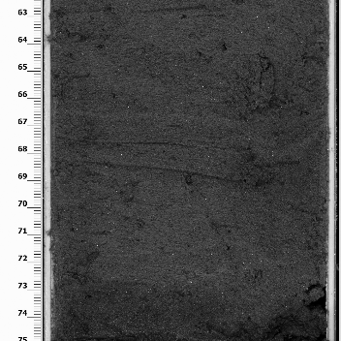
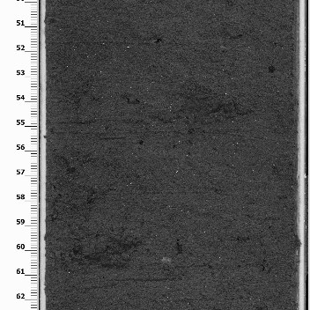
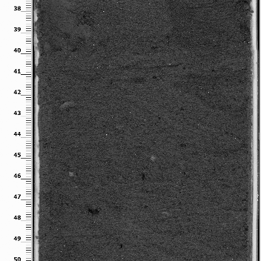
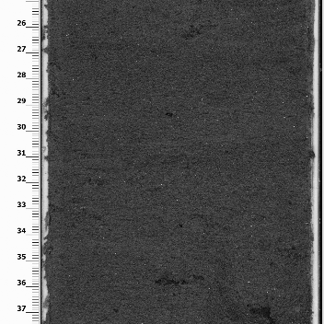
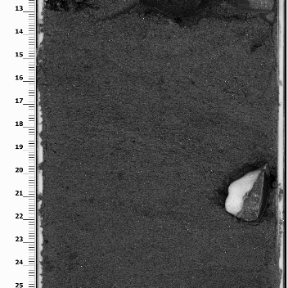
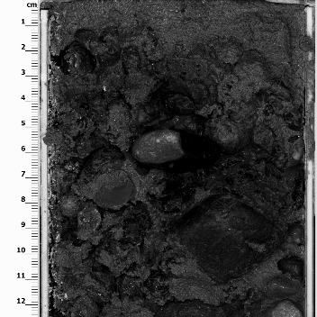





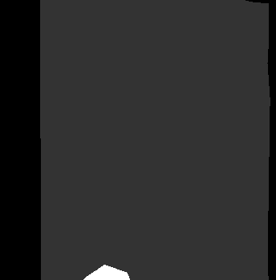
Data Processing: Image splitting
Massive Gravel
Massive Gravel
Laminated Sand

Slide 10
Deep-learning model
Model architecture: U-Net (Tensorflow). Selected based on DiMartino et al., 2023
Used tutorial model: https://youtu.be/XyX5HNuv-xE?si=ywxtReVqf1nxxlzZ
Number of classes:
8 classes: First attempt during M6. Further runs improved during final project.
5 classes: Improving classification accuracy by reduing the number of classes through knowledge-based grouping of the existing classes
Optimizer: Adam
Loss functions attempted: Categorical cross-entropy; Focal loss
Datasets:
77 images for training, split into square sections of 352x352 → 672 sections for training
Used train_test_split
Additionally had set of 12 images, i.e., 100 sections for validation
Tested several epochs and batch sizes

Slide 11
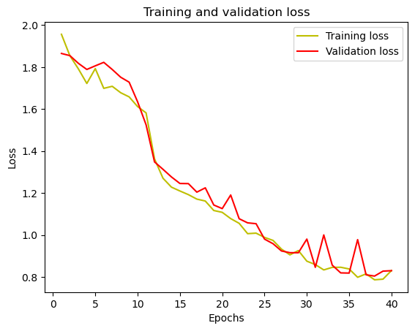
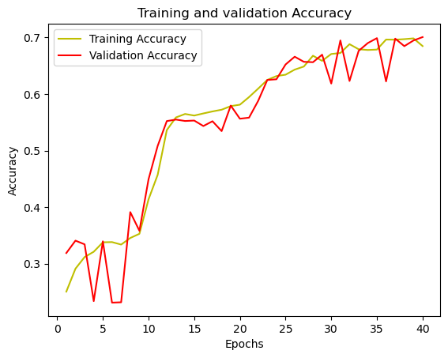
Results: 8 classes
Best model so far: Random splitting, 40 epochs, 10 batches, categorical_crossentropy
IoU of class 0 is: 0.8748682
IoU of class 1 is: 0.6471699
IoU of class 2 is: 0.37699103
IoU of class 3 is: 0.109560125
IoU of class 4 is: 0.6387318
IoU of class 5 is: 0.55518365
IoU of class 6 is: 0.15295659
IoU of class 7 is: 0.0
Notes:
Patricio (30 sec): Increase epoch number (hyperparameter tuning). nnUNet.

Slide 12
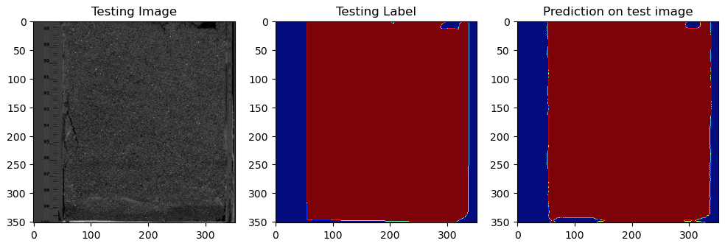
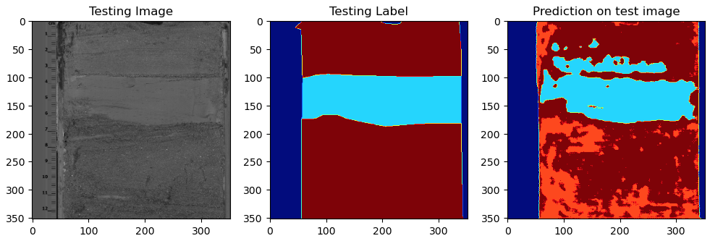
Sample image results: 8 classes

Slide 13
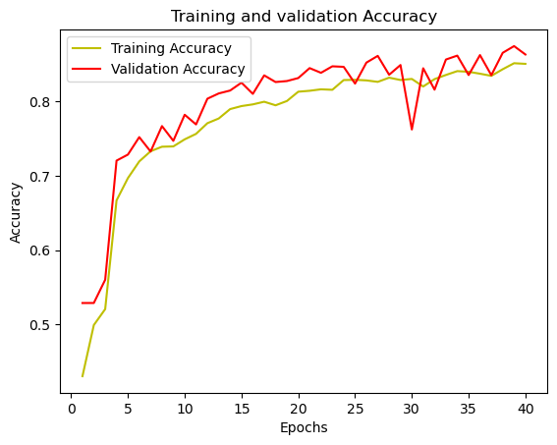
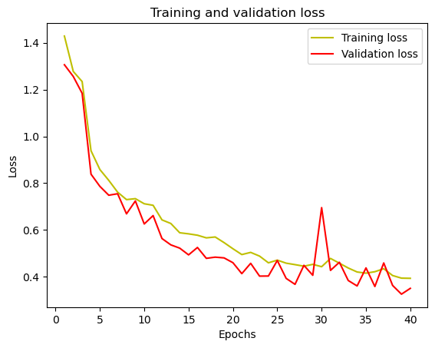
Results: 5 classes
The 8 original classes were re-mapped as follows:
0 = background
1 = Gravel
2 = Fines
3, 4 = 3 = Diamicts
5, 6, 7 = 4 = Sands
Accuracy is: 86.3%
Mean IoU is: 0.612
iou of class 0 is: 0.8946793
iou of class 1 is: 0.5899338
iou of class 2 is: 0.49658573
iou of class 3 is: 0.18805782
iou of class 4 is: 0.89107263

Slide 14
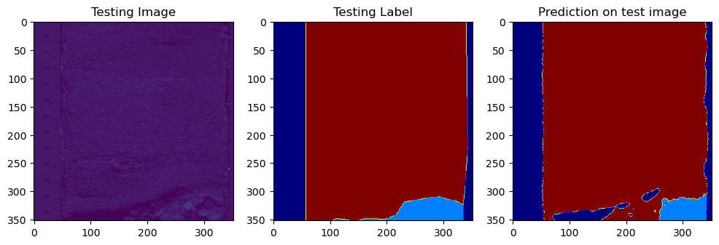
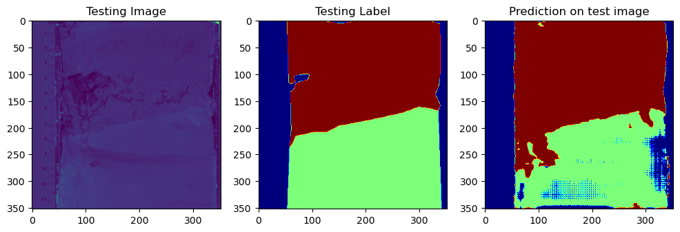
Sample image results: 5 classes
Notes:
Patricio (30 sec)

Slide 15
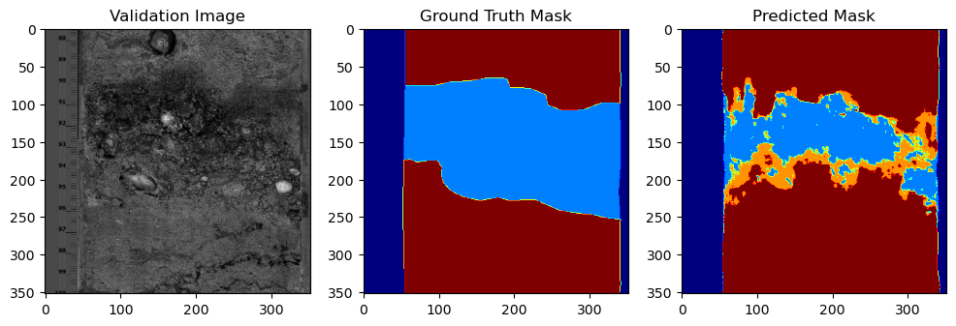
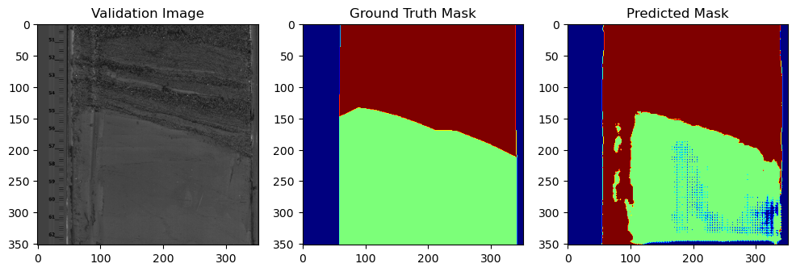
Example results (5 classes – Validation set)
Validation Accuracy: 82.03% Mean IoU = 0.61467546
IoU of class 0 is: 0.9474
IoU of class 1 is: 0.5719
IoU of class 2 is: 0.6719
IoU of class 3 is: 0.1048
IoU of class 4 is: 0.7775
ImId: 39
ImId: 81

Slide 16
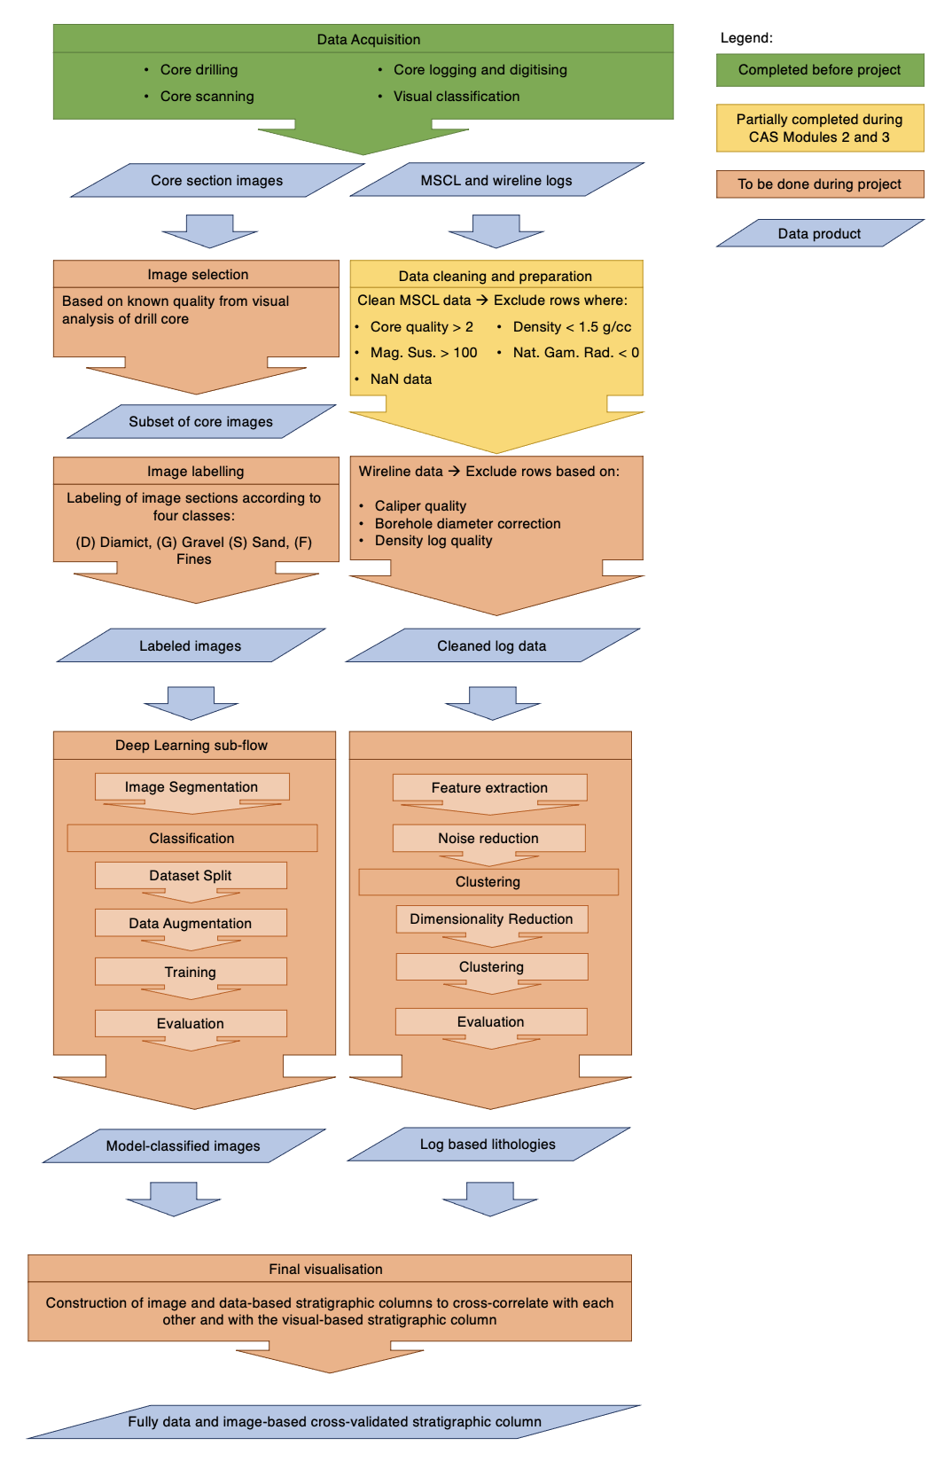
Steps to take the project further
Increase training dataset (up to 1000 images available)
Try validation set
Improve Deep Learning toolset : Tensorflow → Pytorch
Try U-Net pre-trained on ImageNet with various backbones (e.g. EfficientNet)
Data augmentation
Notes:
Patricio (30 sec)

